Slide 1
Khal Drafting

Slide 2
Google Earth Pro:
Google Earth Pro is software provided by Google that ties extensive satellite data together into one system to visualize the earth and study various geographic aspects. It's based on projects going back decades with organizations like Keyhole and has been managed by Google since the mid-2000s.
History of Google Earth:
In August 2005, Hurricane Katrina ravaged the Gulf Coast of the United States, bursting levees throughout Louisiana and Mississippi and submerging the streets of south Florida. According to the National Hurricane Center, it was the deadliest hurricane since 1928. The U.S. Navy, Coast Guard, and other federal relief groups deployed helicopter teams to res
cue people stranded in New Orleans without the resources to escape or survive in their homes. Hurricane victims dialed 911 for urgent help at specific street addresses, but it was impossible for first responders to find them without precise GPS coordinates—street signs and house numbers were invisible beneath the deluge.
In California, a team from the recently minted Google Earth program launched into action, creating real-time imagery overlays of heavily affected areas on top of its existing 3D globe platform. Fly-by aerial photos and satellite imagery revealed the scope of the hurricane’s destruction. Google Earth made this data publicly available and responders had eyes again. Today, Google Earth is among the most popular geospatial software in the world, boasting upward of one billion downloads.
Bangladesh Water Development Board (BWDB)

Slide 3
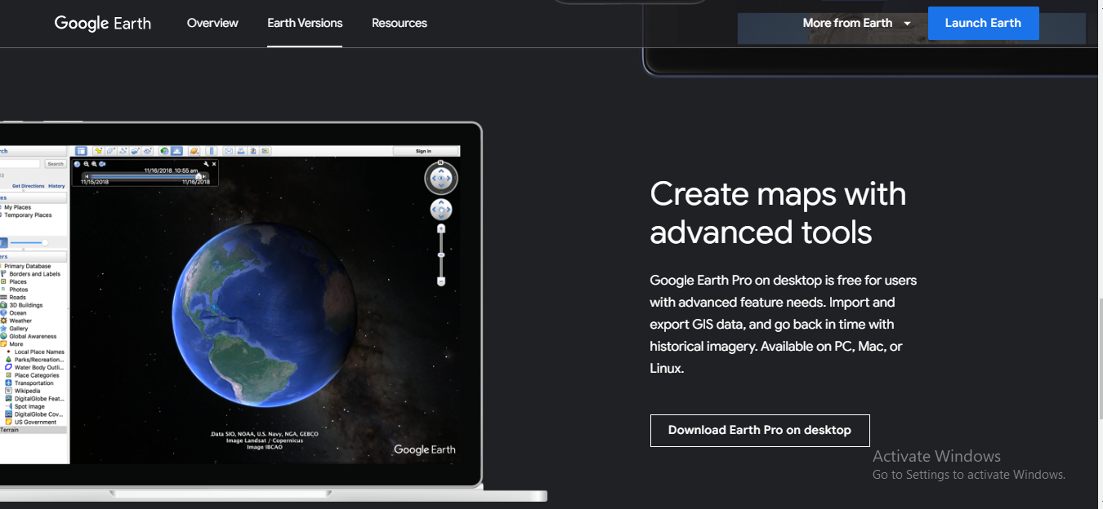
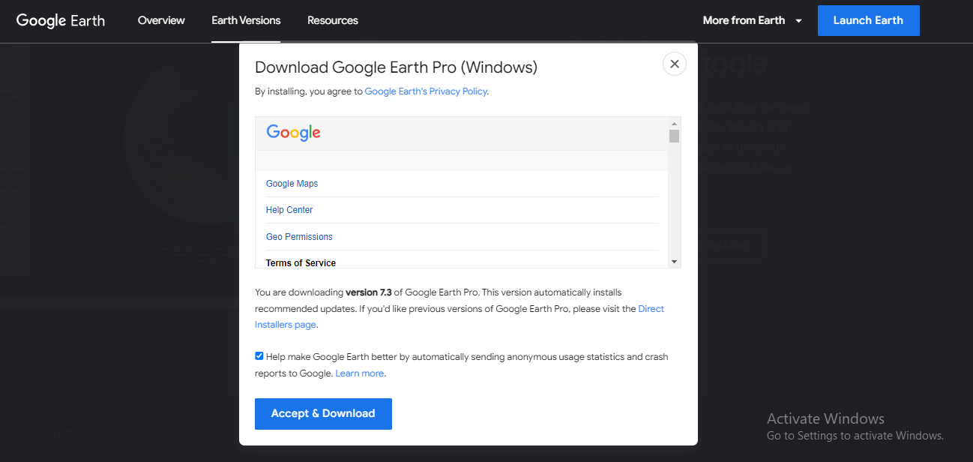
Google Earth Pro
Web link to Download & Installation:
https://www.google.com/earth/versions/#download-pro
Bangladesh Water Development Board (BWDB)

Slide 4
KML File
KML: Keyhole Markup Language
It’s File Format used to display geographic data in earth browser.
KML uses tag-based structure with nested elements and attributes.
KML basically based on xml data format.
Bangladesh Water Development Board (BWDB)

Slide 5
Tag-based structure
Every Tag performs different task.
General Tags: <tagname>Data</tagname>
In special Special Tags:<tagname>
For example: General Tag
<coordinates> -112.265,36.094,630
-112.265,36.095,630 </coordinates>
Above Line Represents coordinates of a Line.
<coordinates> : begins coordinate input.
-112.265,36.094,630 :x,y,z of the first point.
112.265,36.095,630 :x,y,z of the second point.
</coordinates>: end of coordinate input.
Notice:there is no comma between points,.
Bangladesh Water Development Board (BWDB)

Slide 6
Tag-based structure
For example: Special Tag
This type of Tag do not have any definite end.Usually have a beginning and some attributes encoded in them.
<kml xmlns="http://www.opengis.net/kml/2.2">
Abbe Tags says which version of kml shall be used to a certain kml file.
Kml: is the tag name
Xmlns:is a attribute.
Attribute Format:
Each attribute is begin by a name and value of this is given by equal sign. Value of attribute always in string format.That is enclosed by “ ”.
Bangladesh Water Development Board (BWDB)

Slide 7
Creation of KML file on notepad
For the sake of brevity we shall create a KML file from scratch on notepad.
mawa :23.470181, 90.264427,0 (lat,lon,altitude)
Jajira: 23.442196, 90.261215,0 (lat,lon,altitude)
Goal Mark Two points and Connect them with a line.
Open a note pad write:
<?xml version="1.0" encoding="UTF-8"?>
<kml xmlns="http://www.opengis.net/kml/2.2">
<Document>
<name>Padma Bridge</name>
Bangladesh Water Development Board (BWDB)

Slide 8
Creation of KML file on notepad
<Placemark>
<name>Mawa End</name>
<Point> <coordinates>90.26442699999998,23.470181,0 </coordinates>
</Point>
</Placemark>
<Placemark>
<name>Jajira End</name>
<Point>
<coordinates> 90.261215,23.442196,0 </coordinates>
</Point>
</Placemark>
Bangladesh Water Development Board (BWDB)

Slide 9
Creation of KML file on notepad
<Placemark>
<name>Bridge Line</name>
<LineString>
<coordinates>
90.26442699999998,23.470181,0
90.261215,23.442196,0
</coordinates>
</LineString>
</Placemark>
Bangladesh Water Development Board (BWDB)

Slide 10
Thank You!!!!!
Bangladesh Water Development Board (BWDB)

